Slide 1
Finite-difference frequency-domain
(FDFD) method

Slide 2
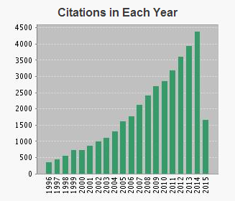

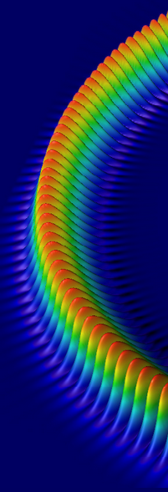


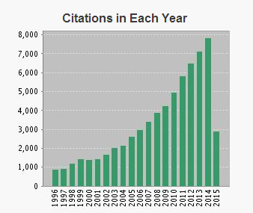



1. Introduction: computational electrodynamics
”Maxwell numerical model*”
”computational optics”
Notes:
Ansus, Spreag

Slide 3
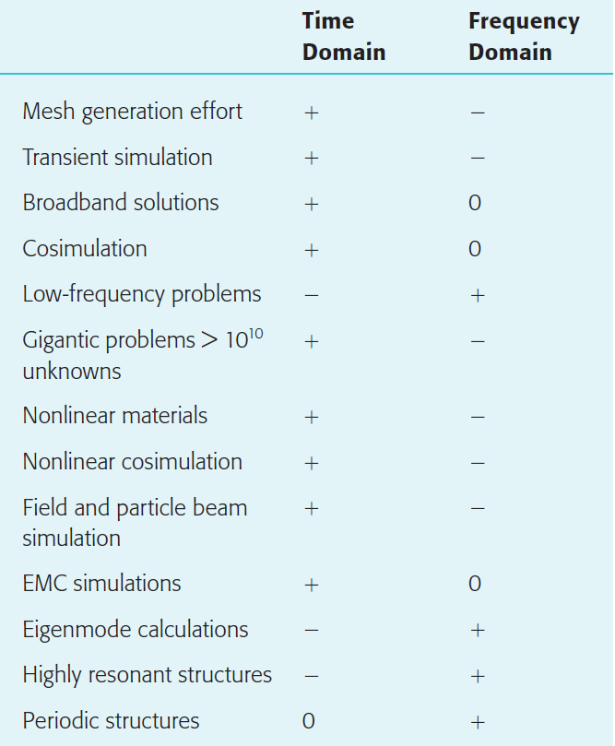
1. Introduction: numerical methods overview
FDTD, FEM,
volume integral methods (VIM),
FDFD, DGTD,
method of lines (MoL),
Fourier modal method,
local eigenmode-modal method,
hybrid methods, Green functions
absorbing layers
[I. Munteanu, M. Timm, T. Weiland, 2010]

Slide 4
1. FDFD formulation: eigenproblem vs wave transmission
Maxwell’s equations
The eigenmode problem: The wave scattering problem:
where
Notes:
Note that in both cases (the eihenmode problem and the scattering wave equation), we have to factorize and solve for the matrix
4

Slide 5
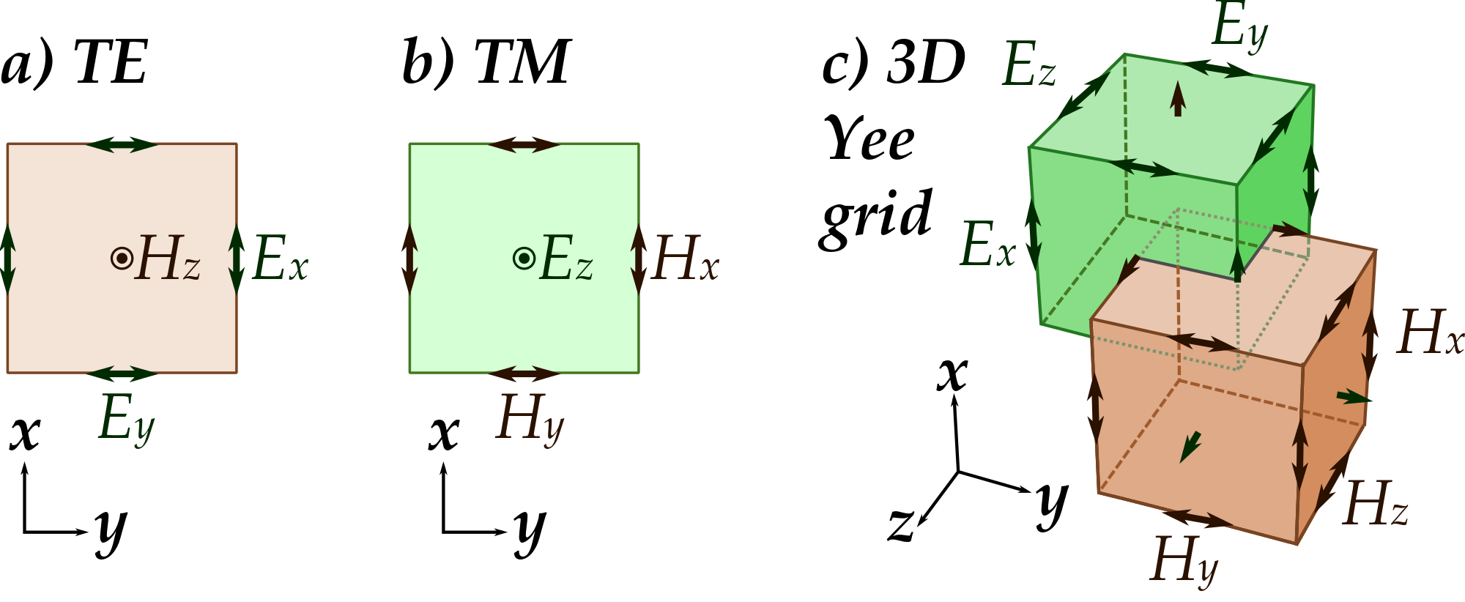
2. FDFD formulation: eigenproblem vs wave transmission

Slide 6
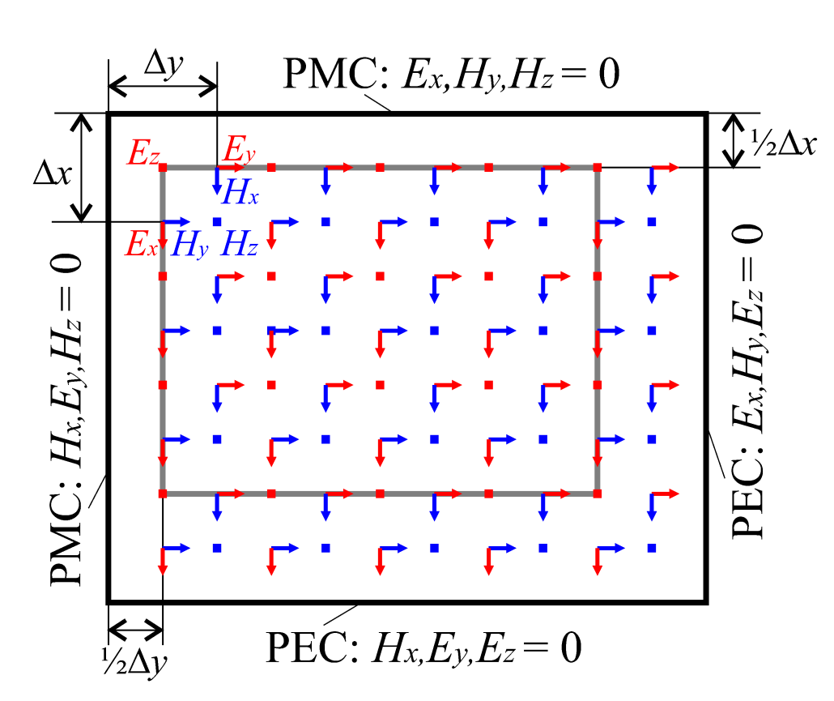
2. FDFD formulation: FDFD eigenproblem
Forward differential:

Slide 7
2. FDFD formulation: Non-uniform Meshes
initial mesh
sub-gridding
alternative: uniformly varying grid density
Notes:
To assure second order convergence, mesh sampling variation should be smooth

Slide 8
1D FDFD: metal cavity

Slide 9
3. 1D problem
Maxwell’s equations
H_{y}
E_{x}
z
Yee unit cell
staggered mesh
Notes:
Note that in both cases (the eihenmode problem and the scattering wave equation), we have to factorize and solve for the matrix
9

Slide 10
3. 1D forward and backward differences
Backward differential:
Forward differential:
eigenmatrix

Slide 11
3. 1D forward and backward differences
Backward differential:
Forward differential:
z₀+Δz/2 … z_{end}-Δz
z
H_{y}
E_{x}
PMC
z₀
PEC
z_{end}

Slide 12


3. 1D PMC-PEC cavity
z
PMC
z₀
=a (domain size)
$$k_{z}=\frac{2π}{λ}$$
$$E_{x}=с_{1}\cos\left(k_{z}z\right)+с_{2}sin⁡(k_{z}z)$$

Slide 13
1D FDFD: periodic solution

Slide 14
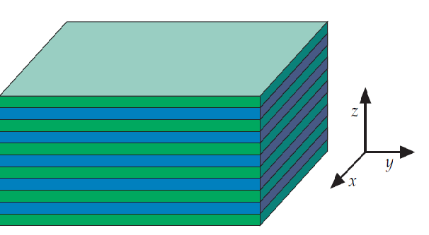
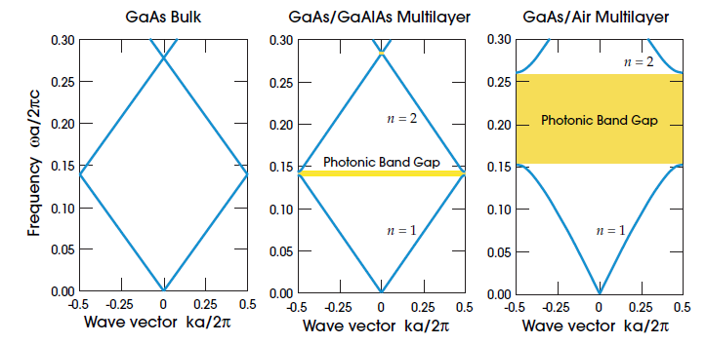
4. Band gap diagrams: multilayers
a
ε=13 ε₁=13, ε₂=12 ε₁=13, ε₂=1

Slide 15
4. Band gap diagrams: 1st formulation
Forward differential:
Backward differential:
eigenmatrix
for particular k_{z}
eigensolution

Slide 16
4. Band gap diagrams : 2nd formulation
Forward differential:
Backward differential:

Slide 17
4. Band gap diagrams : mesh and domain size
a
z₀+Δz/4 … z_{end}-Δz/2-Δz/4
z
H_{y}
E_{x}
z₀
z_{end}
a

Slide 18
Task assignment

Slide 19
5. Assignment
Task1:
Find the modes of the PMC-PEC cavity.
Check how solution improves as discretization becomes finer.
Visualize the field inside the cavity.
Task2:
Build 1D BG diagrams using 1st formulation. For particular k_{z} find several first eigenfrequencies ω_{eig}. (Do not pay attention to peculiarities of mesh generation at domain boundaries, use F and B from previous task. To impose periodicity use cosine fuction.)
Construct the eigenmatrix for a multilayer consisting of two dielectrics of ε₁ and ε₂. Assume the layers have equal thickness. See how BG opens as contrast between ε₁ and ε₂ increases.

Slide 20
5. Chartflow to programming
Choose the domain size, for example, a=1.
Set the number of grid nodes n_{grid}.
Define the discretization unit Δz=a/ n_{grid}.
For periodic conditions define k_{z}.
Define the differential operators F,B, each of size [n_{grid}, n_{grid}].
Define the permittivity array. You will obtain matrix of size [n_{grid}, n_{grid}] with inverse permittivity 1/ε on the main diagonal.
Assemble eigenmatrix. Find eigensolution.

Slide 21
5. Tips to programming
Relevant Matlab functions:
spdiags
ones, repmat
eigs
Relevant Python functions:
numpy.ones
numpy.vstack
scipy.sparse.spdiags
sp.sparse.lil_matrix
scipy.sparse.lil_matrix.transpose
scipy.sparse.linalg.eigs

Slide 22
3D FDFD

Slide 23
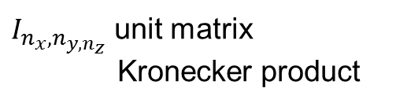
6. 3D FDFD formulation
$I_{n_{x},n_{y,n_{z}}}$ unit matrix
Kronecker product

